Slide 1
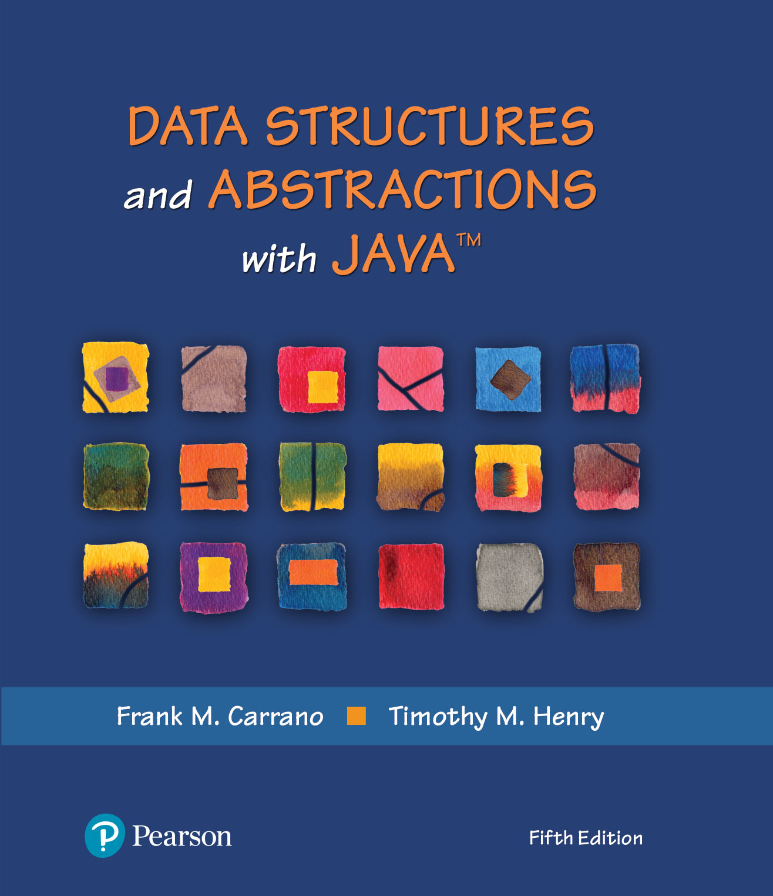
Data Structures and Abstractions with Java™
5th Edition
Module 9 - Recursion
Including:
Chapter 9 – Recursion
Chapter 14 – Problem Solving with Recursion

Slide 2
“To iterate is human, to recurse divine.” L. Peter Deutsch

Slide 3
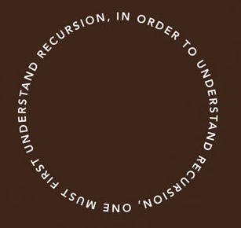

Slide 4
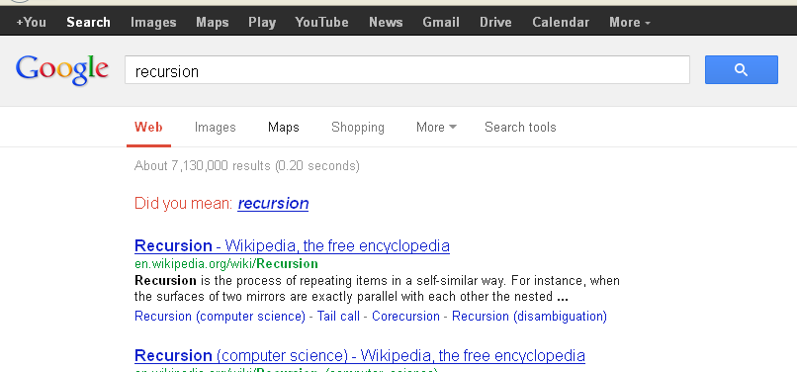

Slide 5
What Is Recursion?
Consider hiring a contractor to build
He hires a subcontractor for a portion of the job
That subcontractor hires a sub-subcontractor to do a smaller portion of job
The last sub-sub- … subcontractor finishes
Each one finishes and reports “done” up the line

Slide 6
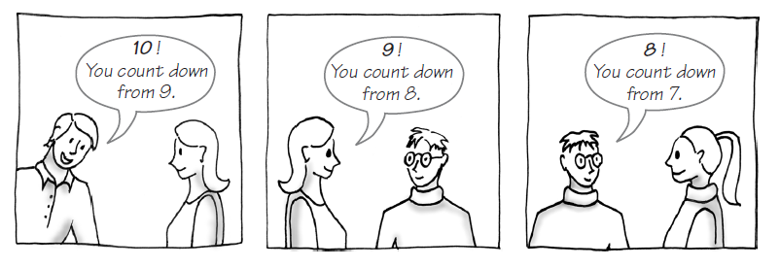
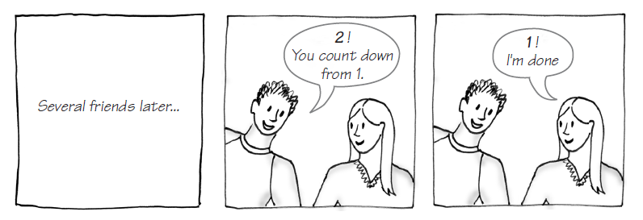
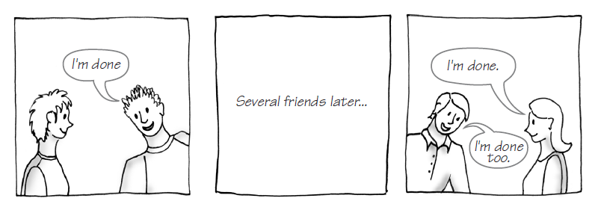
Example: The Countdown
FIGURE 9-1 Counting down from 10

Slide 7
Example: The Countdown
/** Counts down from a given positive integer.
@param integer An integer > 0.
*/
public static void countDown(int integer)
{
System.out.println(integer);
if (integer > 1)
countDown(integer - 1);
} // end countDown
Recursive Java method to do countDown.

Slide 8
Definition
Recursion is a problem-solving process
Breaks a problem into identical but smaller problems.
A method that calls itself is a recursive method.
The invocation is a recursive call or recursive invocation.

Slide 9
Design Guidelines
Method must be given an input value
Method definition must contain logic that involves this input, leads to different cases
One or more cases should provide solution that does not require recursion
Else infinite recursion
One or more cases must include a recursive invocation

Slide 10
Programming Tip
Iterative method contains a loop
Recursive method calls itself
Some recursive methods contain a loop and call themselves
If the recursive method with loop uses while, make sure you did not mean to use an if statement

Slide 11
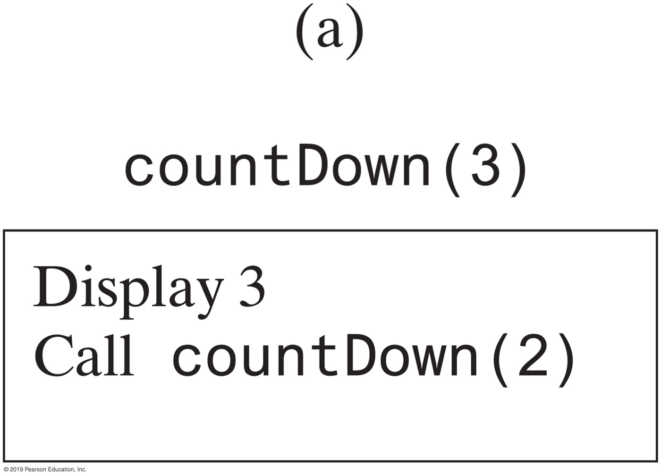
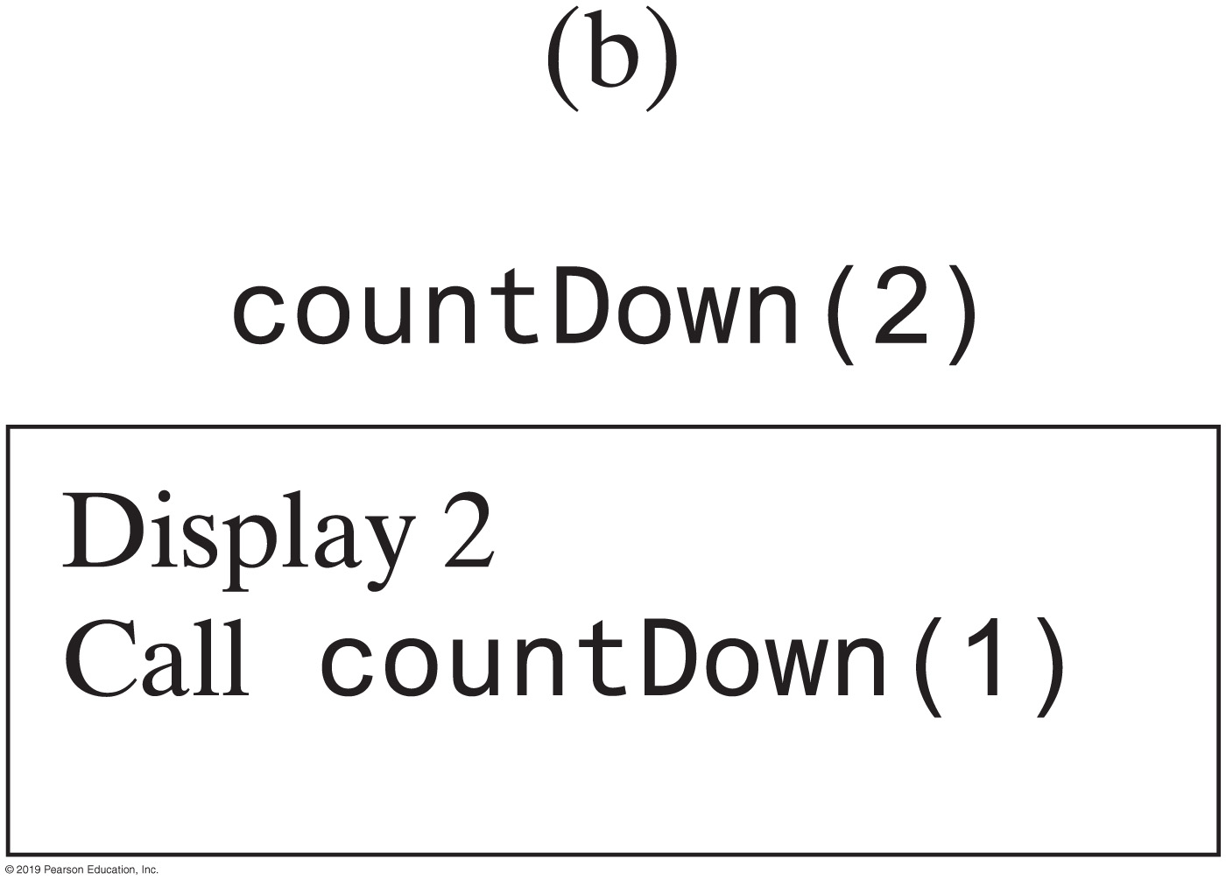
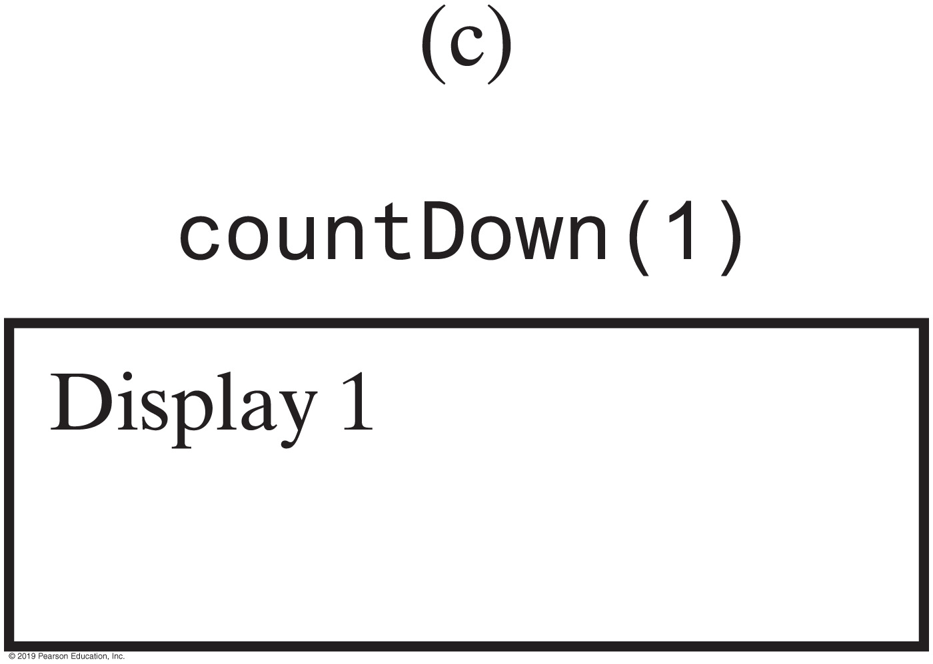
Tracing a Recursive Method
FIGURE 9-2 The effect of the method call countDown(3)

Slide 12
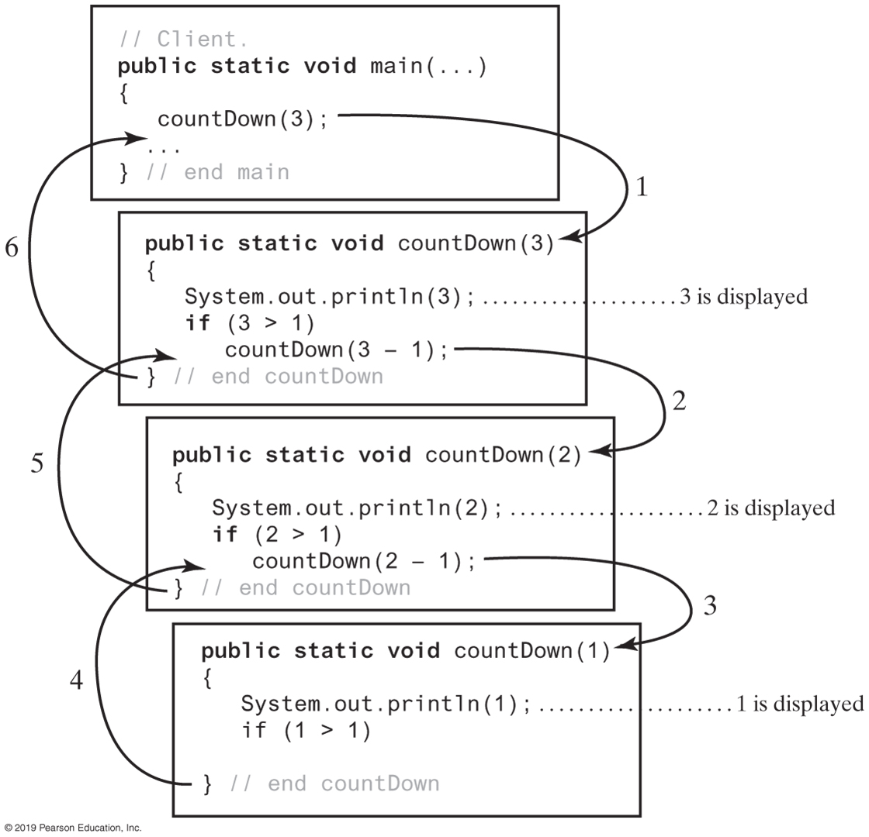
Tracing a Recursive Method
FIGURE 9-3 Tracing the execution of countDown(3)

Slide 13
Stack of Activation Records
Each call to a method generates an activation record
Recursive method uses more memory than an iterative method
Each recursive call generates an activation record
If recursive call generates too many activation records, could cause stack overflow

Slide 14
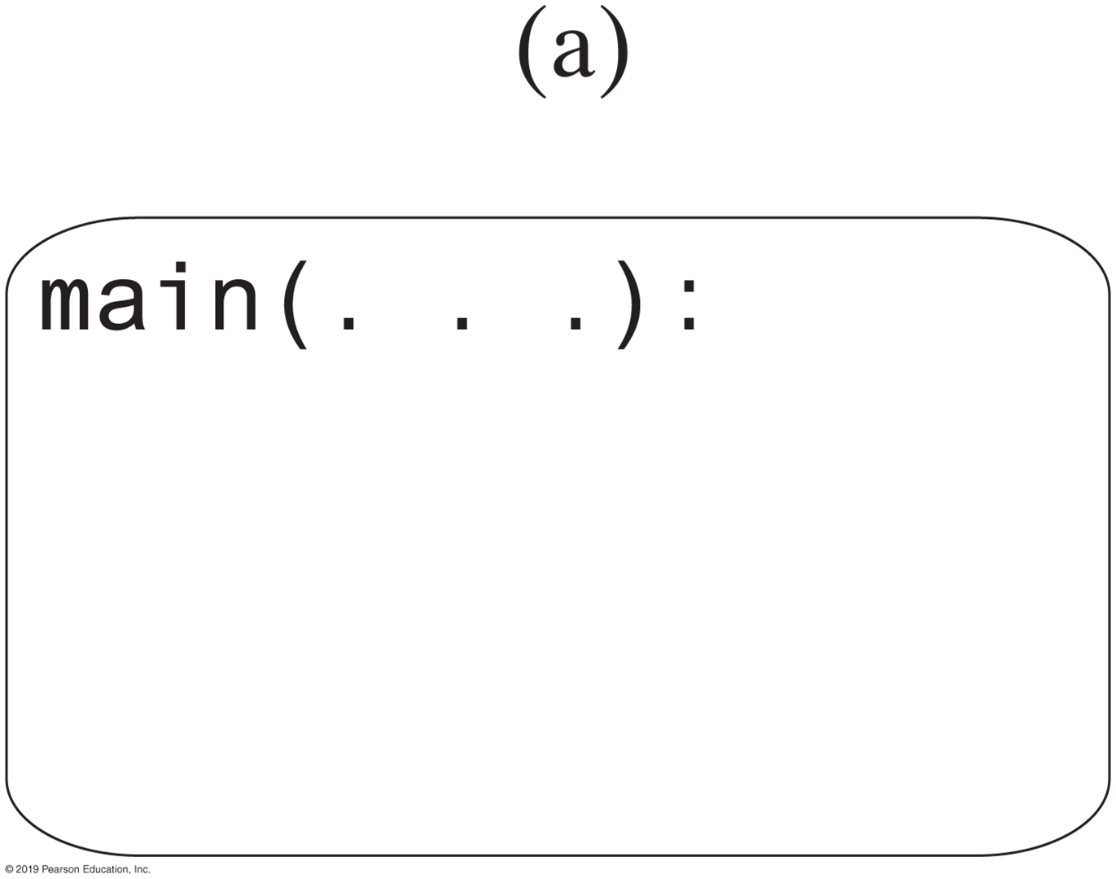
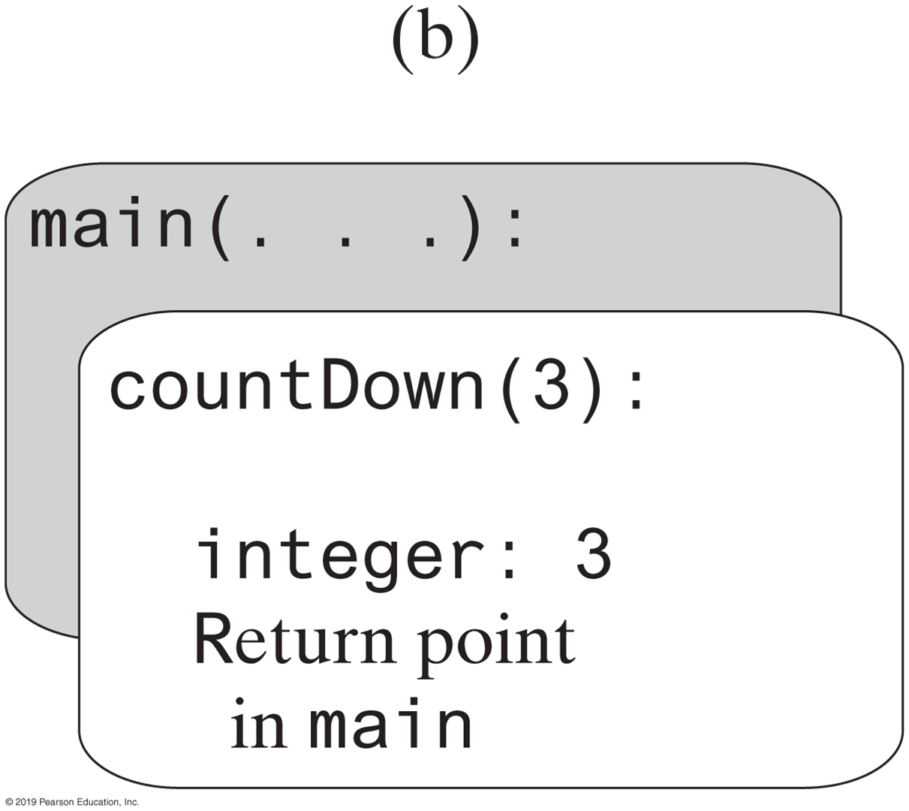
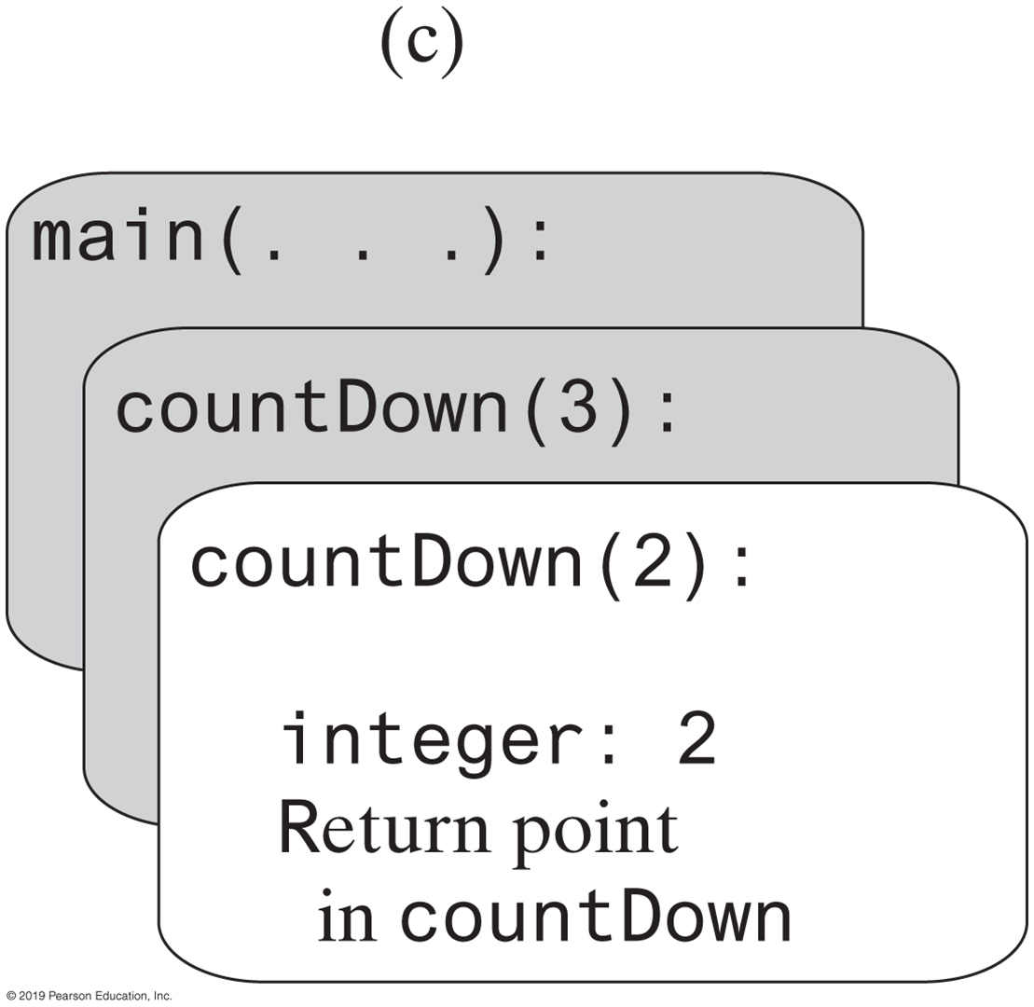
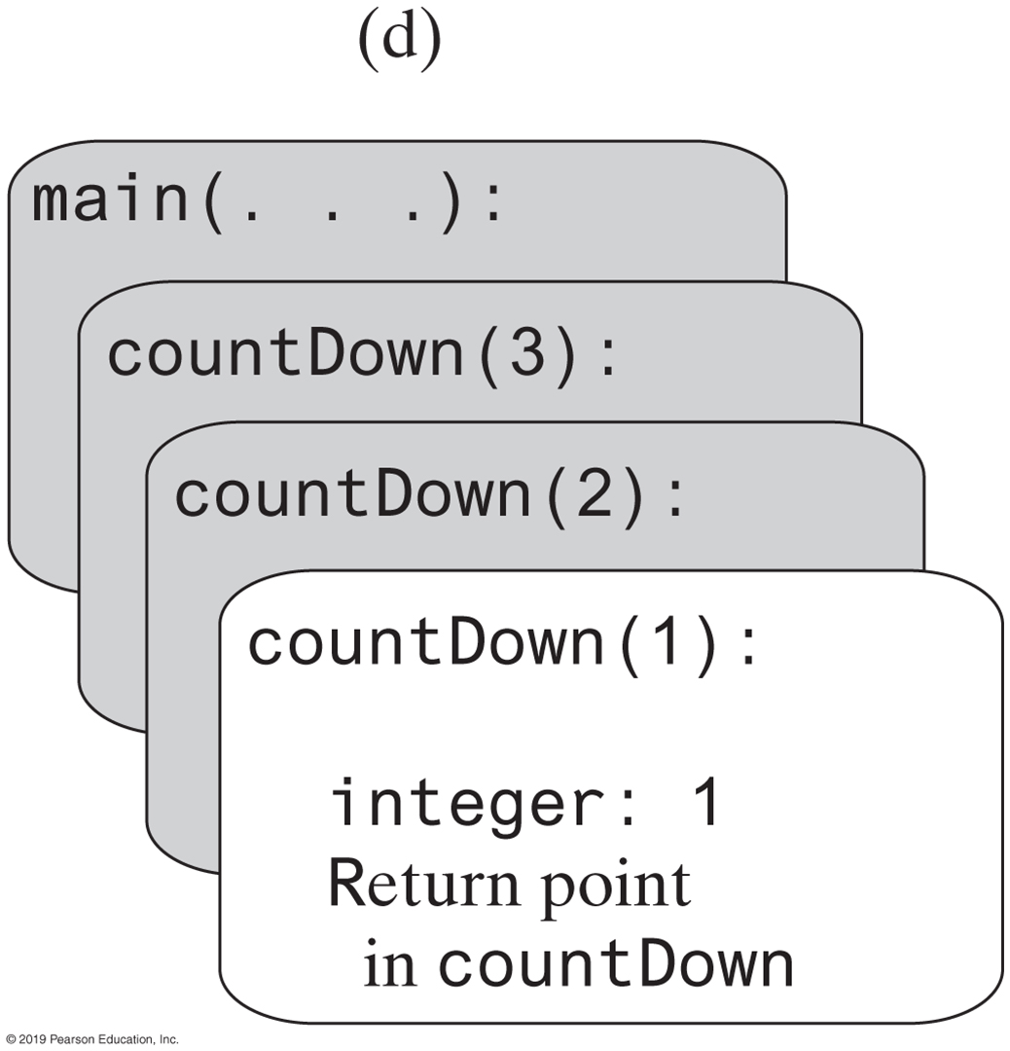

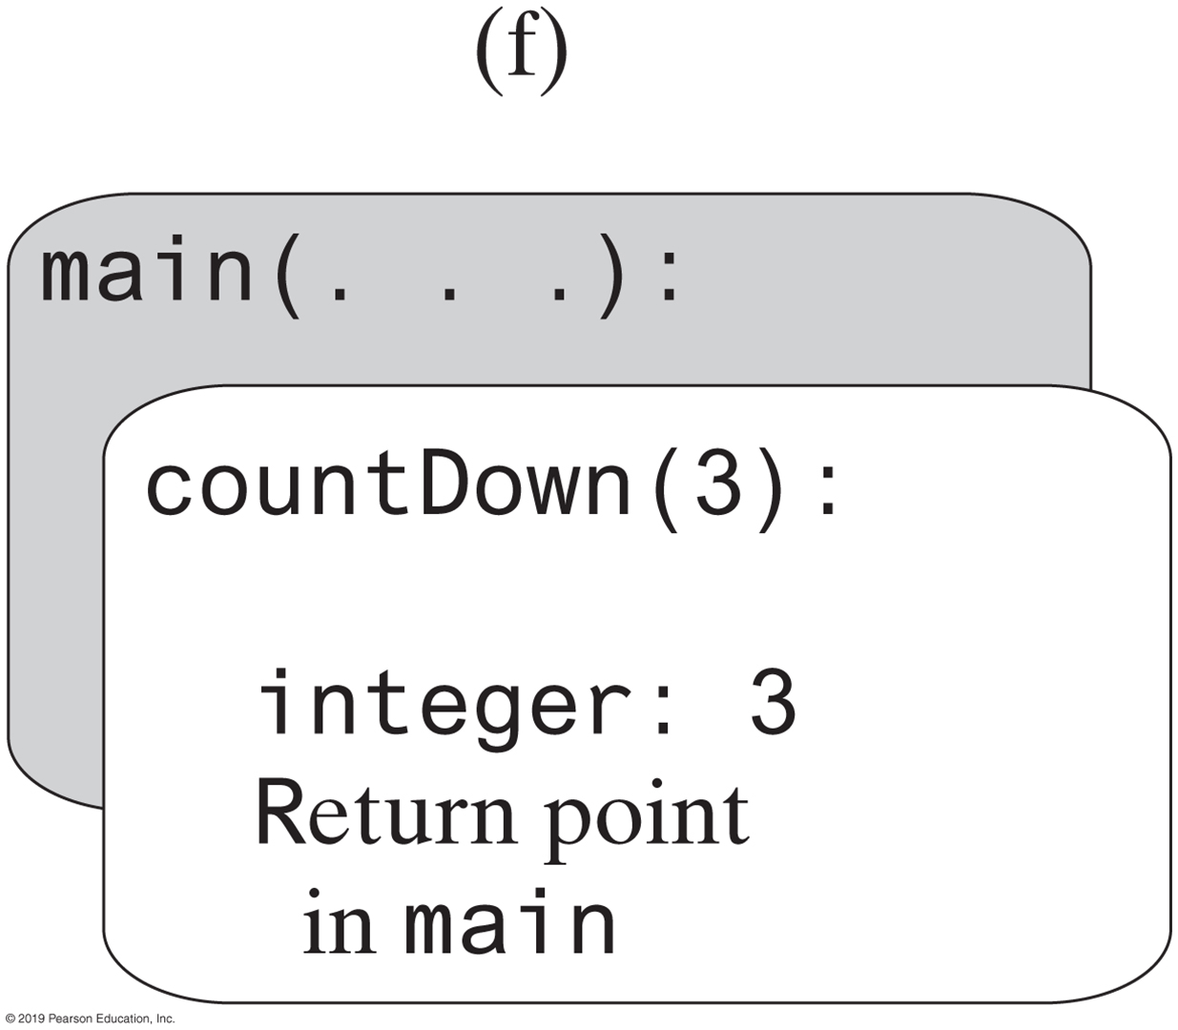
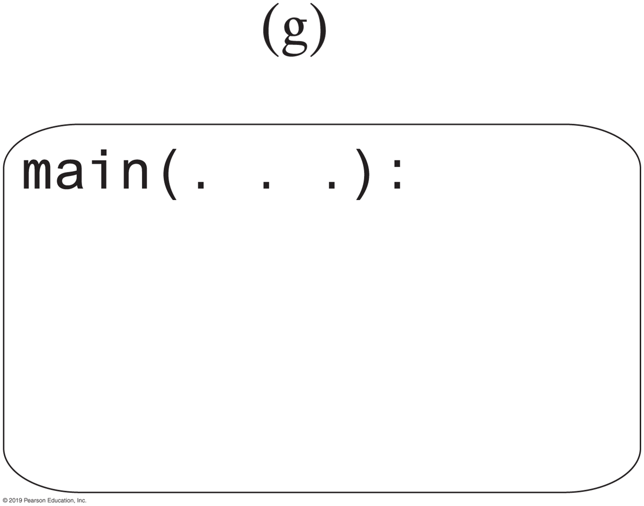
Stack of Activation Records
FIGURE 9-4 The stack of activation records during the execution of the call countDown(3)

Slide 15
A Methodized Approach to the Formulation of Recursive Algorithms
For problems with recursive solutions, the methodology
Is directly applicable to many of them
Can be modified to adapt it to most of them
Four steps
Determine the base case
Determine the reduced problem
Determine the general solution
Combine the base case, reduced problem and general solution to form the recursive algorithm
15

Slide 16
Determining the Base Case
Identify an instance of the problem whose solution is know. Could be an instance when
The solution is defined, or
The instance is a special case, or
There is a trivial solution
Often occurs when n ==0 or n ==1
Examples
0! ≡ 1, a string of length 1, an empty list, a found search item
16

Slide 17
Determining the Reduced Problem
Requires the most imagination and creativity
Look for a problem
Similar to the original problem
Usually a small step away from the original problem, in the direction of the base case
That degenerates into the base case when repeatedly reduced
It should be in between the original problem and the base case, usually very close to the original problem, and must eventually become the base case (when repeatedly reduced)
17

Slide 18
Determining the General Solution
Consider how the reduced problem can be used to
Generate the original problem
Solve the original problem
For example
Original problem n!
Reduced problem: (n-1)!
General solution
Original problem n! = n * reduced problem = n * (n-1)!
18

Slide 19
Determining the Reduced Problem for n! (the base case is 0!)
The reduced problem should be:
Similar to the original problem
Something factorial
A small step away from the original problem in the direction of the base case
(n-1)! or (n-2)! or (n-3!) or ….
That degenerates into the base case when repeatedly reduced
Only (n-1)! will degenerate in to 0! for all n
Therefore (n-1) is chosen as the reduced problem
19

Slide 20
Terminology of Recursive Algorithms Illustrated Using the Problem: n!
Base case ( e.g. 0! = 1 )
The known portion of the problem
Reduced problem ( e.g., (n-1)! )
A problem very “close” to the original problem
Slightly closer to the base case
When reduced, degenerates into the base case
General solution ( e.g., n*(n-1)! )
The solution to the original problem expressed in terms of the reduced problem
20

Slide 21
Code of the Recursive Algorithm for n!
public static long nFactorial(long n)
{ long nMinus1Factorial;
if(n == 0) // base case
return ( 1 );
else
{ // reduced problem
nMinus1Factorial = nFactorial(n-1); // recursion
// general solution
return ( n * nMinus1Factorial);
}
}

Slide 22
Trace of the Evaluation of 4!
4!
24
return (4 * 3!)
6
return (3 * 2!)
2
return (2 * 1!)
1
return (1 * 0!)
1
0!

Slide 23
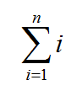
Recursive Methods That Return a Value
/** @param n An integer > 0.
@return The sum 1 + 2 + ... + n. */
public static int sumOf(int n)
{
int sum;
if (n == 1)
sum = 1; // Base case
else
sum = sumOf(n - 1) + n; // Recursive call
return sum;
} // end sumOf
Recursive method to calculate

Slide 24
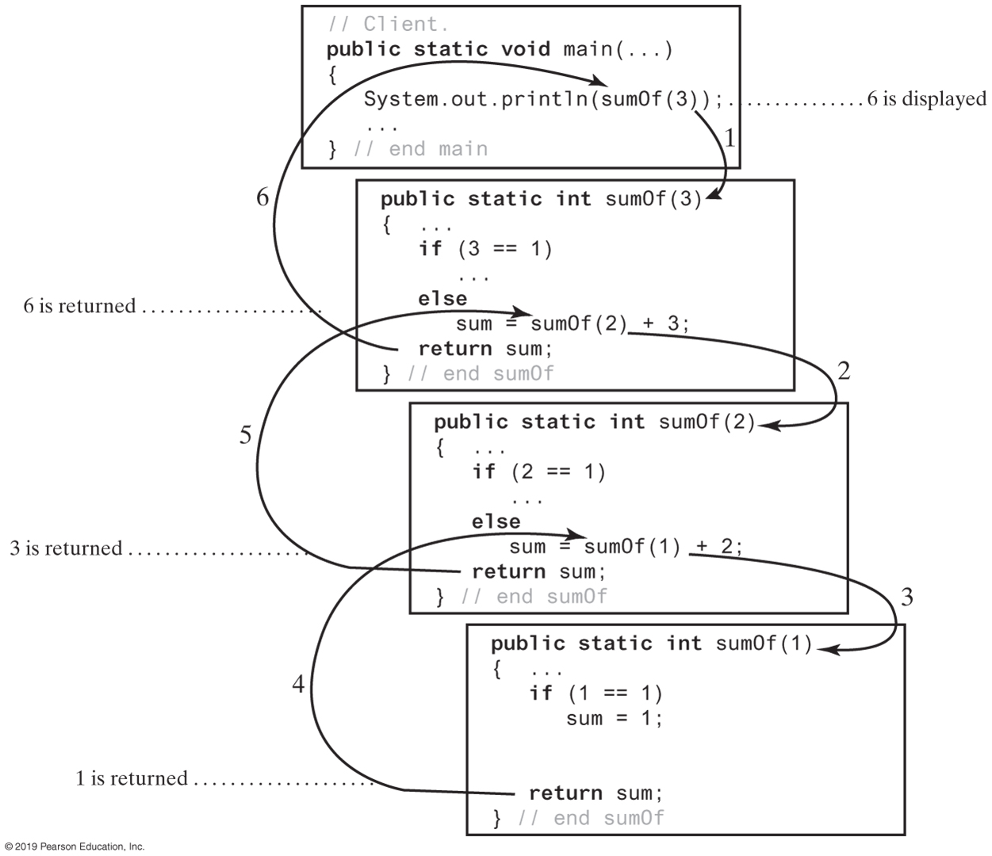
FIGURE 9-5 Tracing the execution of sumOf(3)
FIGURE 9-5 Tracing the execution of sumOf(3)

Slide 25
Recursive Algorithm for Xⁿ
Base case
Problems involving an integer n usually have their base case for n=0 or n=1. Use n=0 because
x^0 ≡ 1
Reduced problem
Candidates are x^(n-1), x^(n-2), x^(n-3)
x^(n-1) is the only one that will become the base case for all n
General solution
xⁿ = x* [x^(n-1)] = x * reduced problem
Combine
25

Slide 26
Recursive Coding of Xⁿ
public static float xToN(double x, int n)
{ if(x == 0) // base case
return 1;
else
{ int rp = xToN(x, n-1); // reduced problem (recursion)
float gs = x* rp; // calculate the general solution
return gs; // return the general solution
{
26

Slide 27
Recursive Algorithm for the nth Term, Fn in the Fibonacci Sequence (multiple base cases)
Base case
A defined solution for n = 0 and n = 1.
F1 ≡ 1, F2 ≡ 1
Reduced Problem
Fn-1 and Fn-2 are close to original problem, and will become one of the base cases when further reduced
General solution (by definition)
Fn ≡ Sum of reduced problems = Fn-1 + Fn-2
Combine
27

Slide 28
Recursive Coding of the nth Term of the Fibonacci Sequence
public static long fibonacci(int n)
{ if(n == 1 || n == 2) //one of the 2 base cases
return 1;
else
{ long rp1 = fibonacci(n - 1); // first reduced problem
long rp2 = fibonacci(n - 2); // second reduced problem
gs = rp1 + rp2; // general solution
return gs;
}
}
28

Slide 29
Recursively Processing an Array
/** Displays the integers in an array.
@param array An array of integers.
@param first The index of the first integer displayed.
@param last The index of the last integer displayed,
0 <= first <= last < array.length. */
public static void displayArray(int[] array, int first, int last)
Given definition of a recursive method to display array.

Slide 30
Recursively Processing an Array
public static void displayArray(int array[], int first, int last)
{
System.out.print(array[first] + " ");
if (first < last)
displayArray(array, first + 1, last);
} // end displayArray
Starting with array[first]

Slide 31
Recursively Processing an Array
public static void displayArray(int array[], int first, int last)
{
if (first <= last)
{
displayArray(array, first, last - 1);
System.out.print(array[last] + " ");
} // end if
} // end displayArray
Starting with array[last]

Slide 32
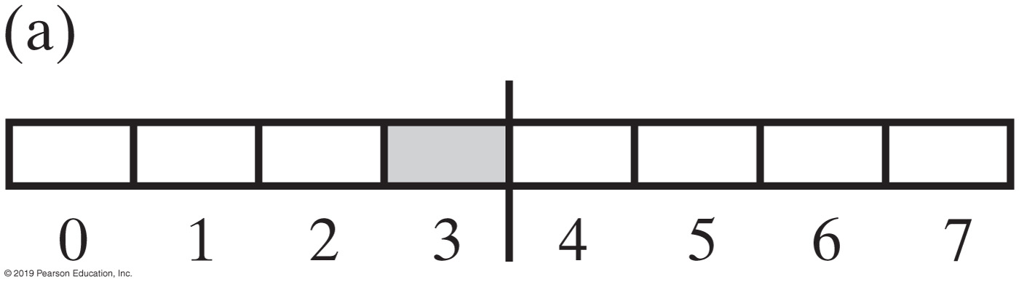
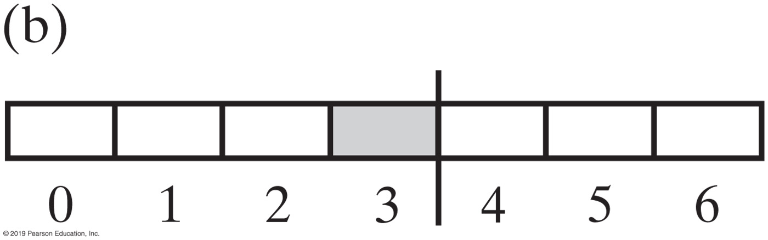
Recursively Processing an Array
FIGURE 9-6 Two arrays with their middle elements within their left halves

Slide 33
Recursively Processing an Array
public static void displayArray(int array[], int first, int last)
{
if (first == last)
System.out.print(array[first] + " ");
else
{
int mid = (first + (last - first) / 2;
displayArray(array, first, mid);
displayArray(array, mid + 1, last);
} // end if
} // end displayArray
Why?
Processing array from middle.

Slide 34
Recursive Algorithm to Output a String of Length n in Reverse Order
Base case
Problems involving an integer n usually have their base case for n=0 or n=1. Use n = 0, no output
Reduced problem
Candidates are output n-1, or n-2, or n-3, … characters in reverse order
Output n-1 characters in reverse order is the only one that will become the base case for all n
General solution
Output the nth character, output the first n-1 characters in reverse order
Combine
34

Slide 35
Code to Output a String of Length n in Reverse Order
public static void stringReverse(String s, int n)
{ if(n == 0) // base case
return;
else // general solution
{ System.out.print(s.charAt(n-1)); // output last character
stringReverse(s, n-1); // reduced problem (recursion)
}
}
35

Slide 36
Code to Output a String of Length n in Reverse Order (hidden base case)
This can be rewritten with a hidden base case
public static void stringReverse(String s, int n)
{ if(n > 0) // general case
{
System.out.print(s.charAt(n-1)); // output last character
stringReverse(s, n-1); // reduced problem (recursion)
}
}

Slide 37
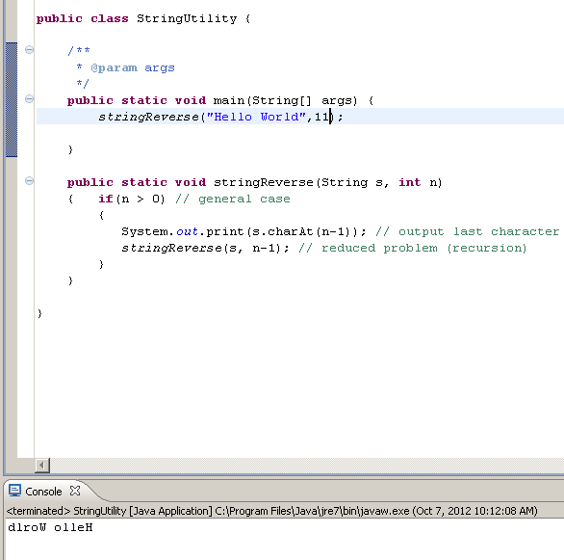

Slide 38
Displaying a Bag
public void display()
{
displayArray(0, numberOfEntries - 1);
} // end display
private void displayArray(int first, int last)
{
System.out.println(bag[first]);
if (first < last)
displayArray(first + 1, last);
} // end displayArray
Recursive method that is part of an implementation of an ADT often is private.

Slide 39
Recursively Processing a Linked Chain
public void display()
{
displayChain(firstNode);
} // end display
private void displayChain(Node nodeOne)
{
if (nodeOne != null)
{
System.out.println(nodeOne.getData()); // Display data in first node
displayChain(nodeOne.getNextNode()); // Display rest of chain
} // end if
} // end displayChain
Display data in first node and recursively display data in rest of chain.

Slide 40
Recursively Processing a Linked Chain
public void displayBackward()
{
displayChainBackward(firstNode);
} // end displayBackward
private void displayChainBackward(Node nodeOne)
{
if (nodeOne != null)
{
displayChainBackward(nodeOne.getNextNode());
System.out.println(nodeOne.getData());
} // end if
} // end displayChainBackward
Displaying a chain backwards. Traversing chain of linked nodes in reverse order easier when done recursively.

Slide 41
Time Efficiency of Recursive Methods
public static void countDown(int n)
{
System.out.println(n);
if (n > 1)
countDown(n - 1);
} // end countDown
Using proof by induction, we conclude method is O(n).

Slide 42
Time Efficiency of Computing x^{n}
x^{n} = (x^{n/2})² when n is even and positive
x^{n} = x (x ^{(n - 1)/2})² when n is odd and positive
x⁰ = 1
Efficiency of algorithm is O(log n)

Slide 43
Tail Recursion
When the last action performed by a recursive method is a recursive call.
In a tail-recursive method, the last action is a recursive call
This call performs a repetition that can be done by using iteration.
Converting a tail-recursive method to an iterative one is usually a straightforward process.
public static void countDown(int n)
{
System.out.println(n);
if (n > 1)
countDown(n - 1);
} // end countDown

Slide 44
Using a Stack Instead of Recursion
Converting a recursive method to an iterative one
public static void countDown(int integer)
{
if (integer >= 1)
{
System.out.println(integer);
countDown(integer - 1);
} // end if
} // end countDown
An iterative version
public static void countDown(int integer)
{
while (integer >= 1)
{
System.out.println(integer);
integer = integer − 1;
} // end while
} // end countDown

Slide 45
Using a Stack Instead of Recursion
An iterative displayArray to maintain its own stack
public void displayArray(int first, int last)
{
boolean done = false;
StackInterface<Record> programStack = new LinkedStack<>();
programStack.push(new Record(first, last));
while (!done && !programStack.isEmpty())
{
Record topRecord = programStack.pop();
first = topRecord.first;
last = topRecord.last;
if (first == last)
System.out.println(array[first] + " ");
else
{
int mid = first + (last - first) / 2;
// Note the order of the records pushed onto the stack
programStack.push(new Record(mid + 1, last));
programStack.push(new Record(first, mid));
} // end if
} // end while
} // end displayArray

Slide 46
Interesting Problems Whose Solutions Involve Recursion
Knight’s tour:
move a knight around a checkerboard such that it visits each square only once
Queens Eight:
Place eight queens on a checkerboard
such that they cannot capture each other
Numeric puzzle:
Enter a 1, or 2, …, or 9 in each cell of a 9x9 grid such that each row, column, and 3x3 sub-grid contains 1→9
Towers of Hanoi:
Q
Q
Q
Q
Q
Q
Q
Q
5 | 8 | 2 | 1 | 3 | 4 | 9 | 7 | 6
3 | 4 | 9 | 5 | 6 | 7 | 1 | 2 | 8
7 | 6 | 1 | 9 | 2 | 8 | 4 | 3 | 5
8 | 2 | 3 | 4 | 9 | 1 | 5 | 6 | 7
4 | 7 | 5 | 3 | 8 | 6 | 2 | 9 | 1
1 | 9 | 6 | 7 | 5 | 2 | 3 | 8 | 4
2 | 5 | 8 | 6 | 1 | 9 | 7 | 4 | 3
9 | 3 | 7 | 8 | 4 | 5 | 6 | 1 | 2
6 | 1 | 4 | 2 | 7 | 3 | 8 | 5 | 9
Move one ring at a time, never placing a large ring on a smaller ring
46

Slide 47
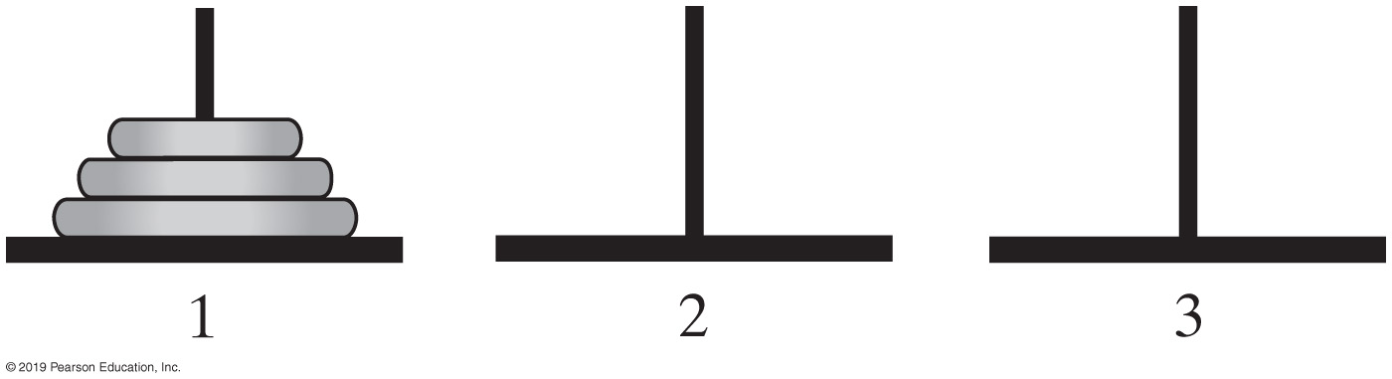
Simple Solution to a Difficult Problem
FIGURE 14-1 The initial configuration of the Towers of Hanoi for three disks

Slide 48
Simple Solution to a Difficult Problem
Rules:
Move one disk at a time. Each disk moved must be the topmost disk.
No disk may rest on top of a disk smaller than itself.
You can store disks on the second (extra) pole temporarily, as long as you observe the previous two rules.
© 2015 Pearson Education, Inc., Upper Saddle River, NJ. All rights reserved.

Slide 49
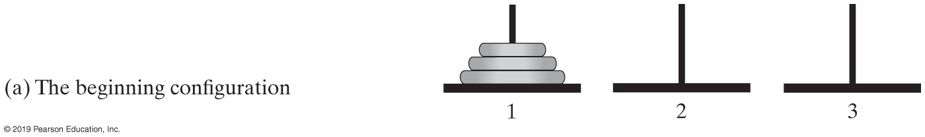
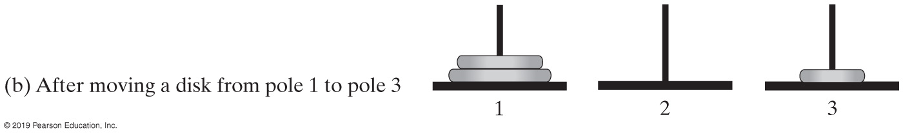
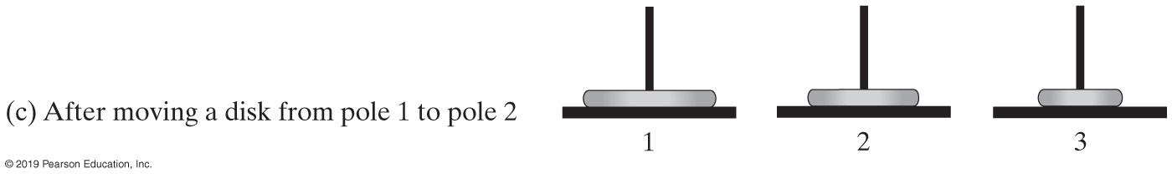
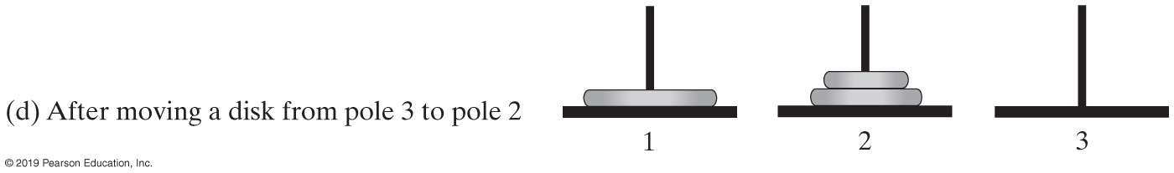
Simple Solution to a Difficult Problem (Part 1)
FIGURE 14-2 Sequence of moves for solving Towers of Hanoi problem with 3 disks

Slide 50
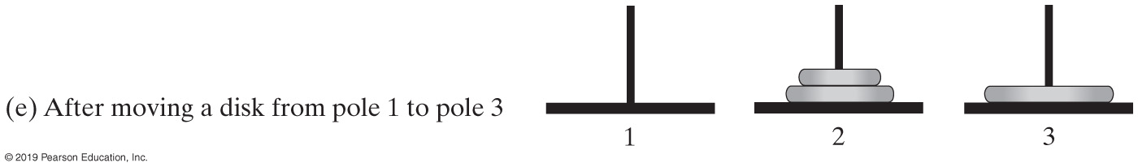
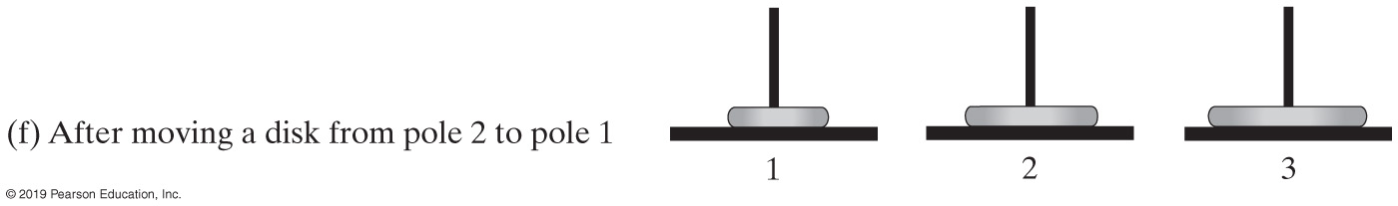
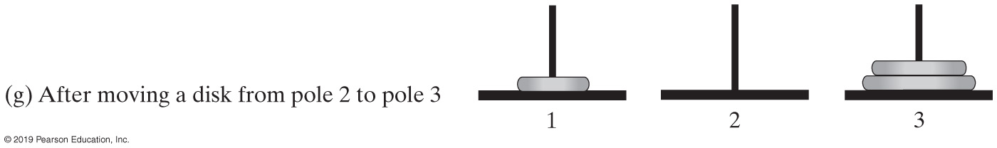
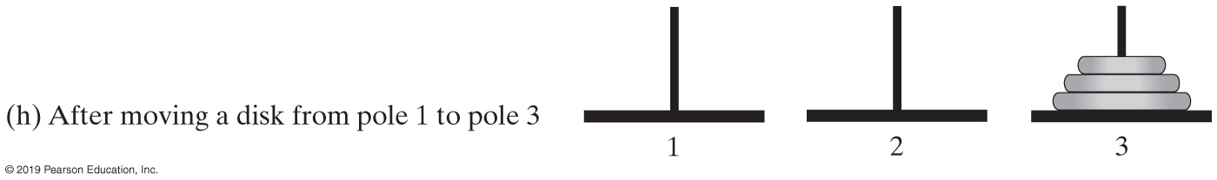
Simple Solution to a Difficult Problem (Part 2)
FIGURE 14-2 Sequence of moves for solving Towers of Hanoi problem with 3 disks

Slide 51
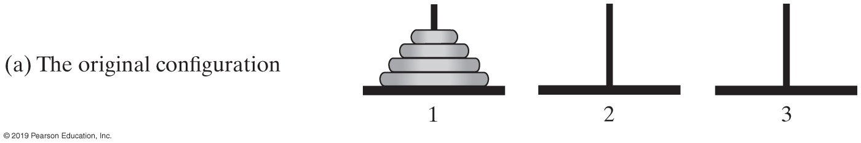
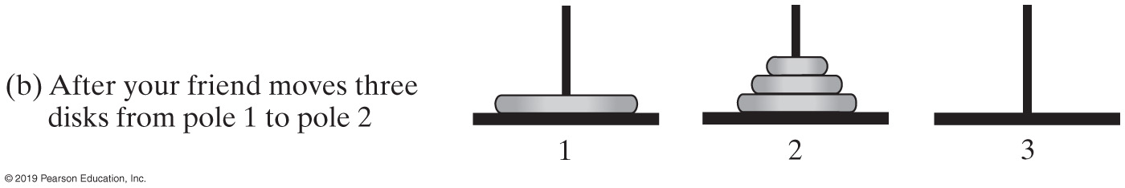
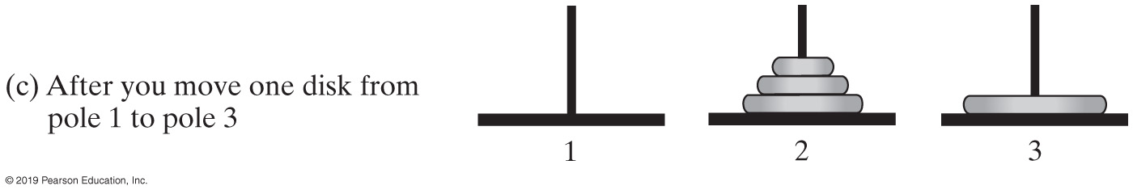
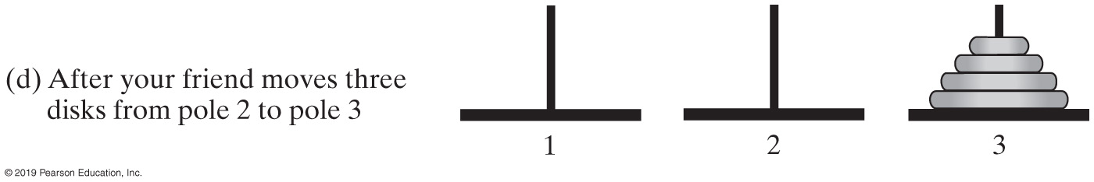
A Smaller Problem
FIGURE 14-3 The smaller problems in a recursive solution for four disks

Slide 52
Solutions
Algorithm to move numberOfDisks disks from startPole to endPole using tempPole
as a spare according to the rules of the Towers of Hanoi problem
if (numberOfDisks == 1)
Move disk from startPole to endPole
else
{
Move all but the bottom disk from startPole to tempPole
Move disk from startPole to endPole
Move all disks from tempPole to endPole
}
Recursive algorithm to solve any number of disks. Note: for n disks, solution will be 2^{n} – 1 moves

Slide 53
Recursive Solution to the Towers of Hanoi
Base case
A trivial solution (n = 1): move 1 ring from one tower to another
Reduced problem
Candidates are move n-1, or n-2, or n-3, … rings from one tower to another
Move n-1 rings is the only one that will become the base case for all n
General solution
Move n-1 rings from S to E (Source to Extra tower)
Move 1 ring from S to D (Source to Destination tower)
Move n-1 rings from E to D (Extra to Destination tower)
Combine
S
D
E
S
D
E
53

Slide 54
Code of the Recursive Solution to the Towers of Hanoi
public static void hanoi(int n, int S, int D, int E)
{ if(n == 1) // base case
System.out.println("move 1 ring from tower " + S + " to tower " + D);
else // general solution
{ hanoi(n-1, S, E, D); // reduced problem
System.out.println("move 1 ring from tower " + S + " to tower " + D);
hanoi(n-1, E, D, S); // reduced problem
}
}
54

Slide 55
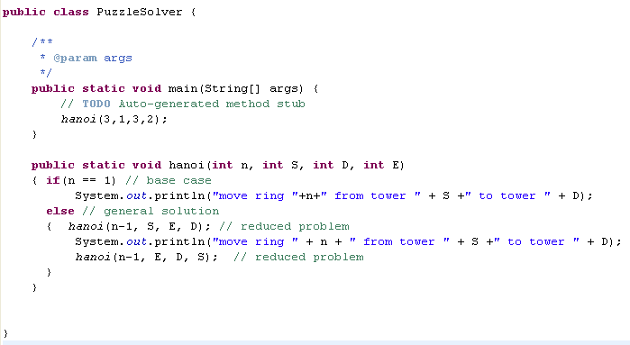
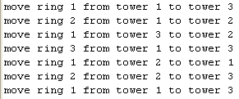

Slide 56
Poor Solution to a Simple Problem
F0 = 1
F1 = 1
Fn = Fn - 1 + Fn - 2 when n ≥ 2
Algorithm Fibonacci(n) if (n <= 1)
return 1
else
return Fibonacci(n − 1) + Fibonacci(n − 2)
Algorithm to generate Fibonacci numbers.
Why is this inefficient?

Slide 57
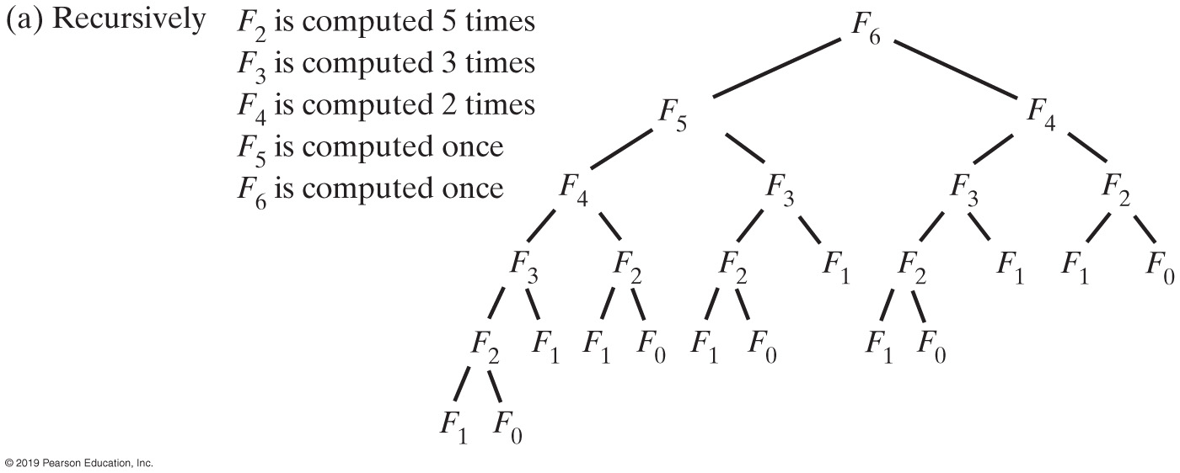
Poor Solution to a Simple Problem
FIGURE 14-4a The computation of the Fibonacci number F6

Slide 58
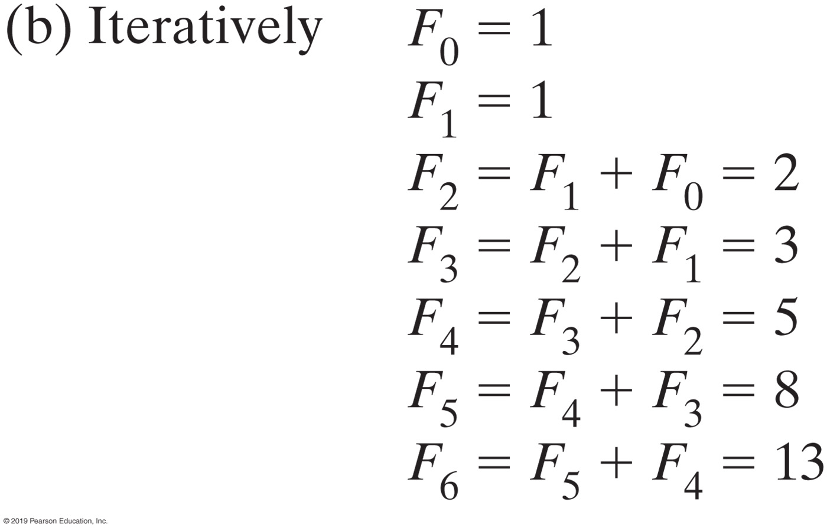
Poor Solution to a Simple Problem
FIGURE 14-4b The computation of the Fibonacci number F6

Slide 59
Indirect Recursion
Example
Method A calls Method B
Method B calls Method C
Method C calls Method A
Difficult to understand and trace
But does happen occasionally

Slide 60
Indirect Recursion
Consider evaluation of validity of an algebraic expression
Algebraic expression is either a term or two terms separated by a + or – operator
Term is either a factor or two factors separated by a * or / operator
Factor is either a variable or an algebraic expression enclosed in parentheses
Variable is a single letter

Slide 61
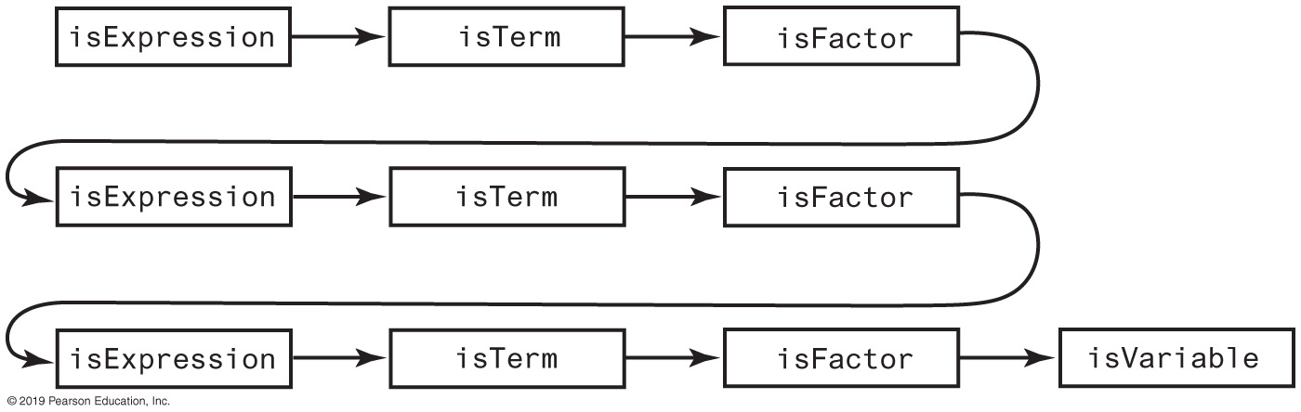
Indirect Recursion
FIGURE 14-5 An example of indirect recursion

Slide 62
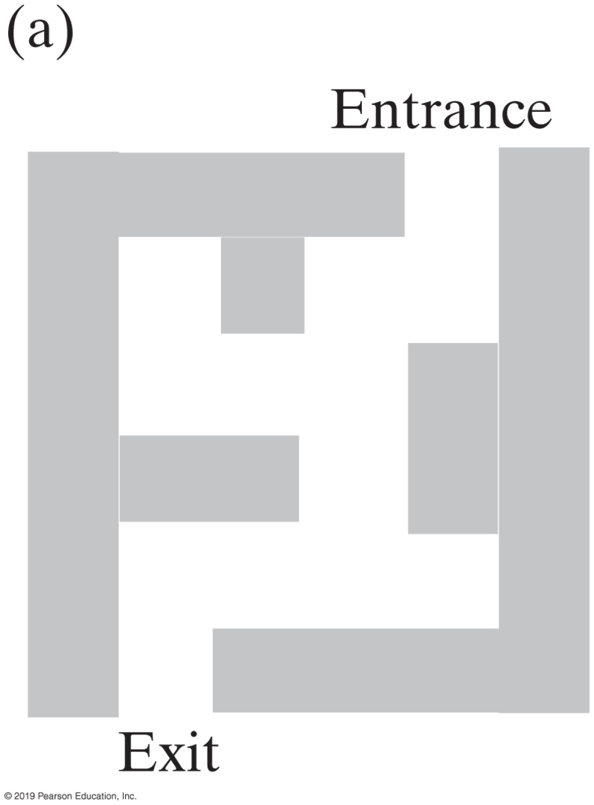
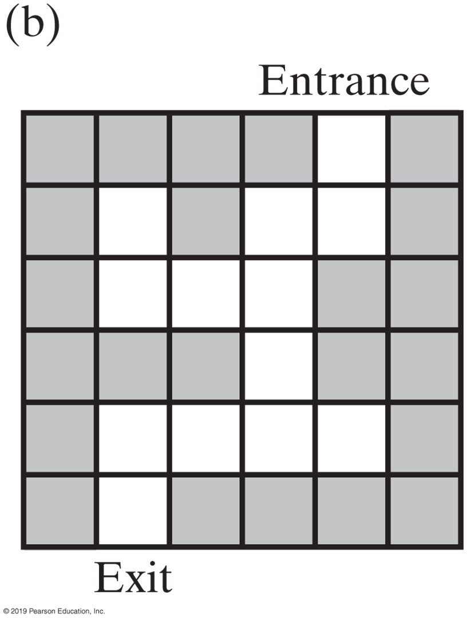
Backtracking
FIGURE 14-6 A two-dimensional maze with one entrance and one exit

Slide 63
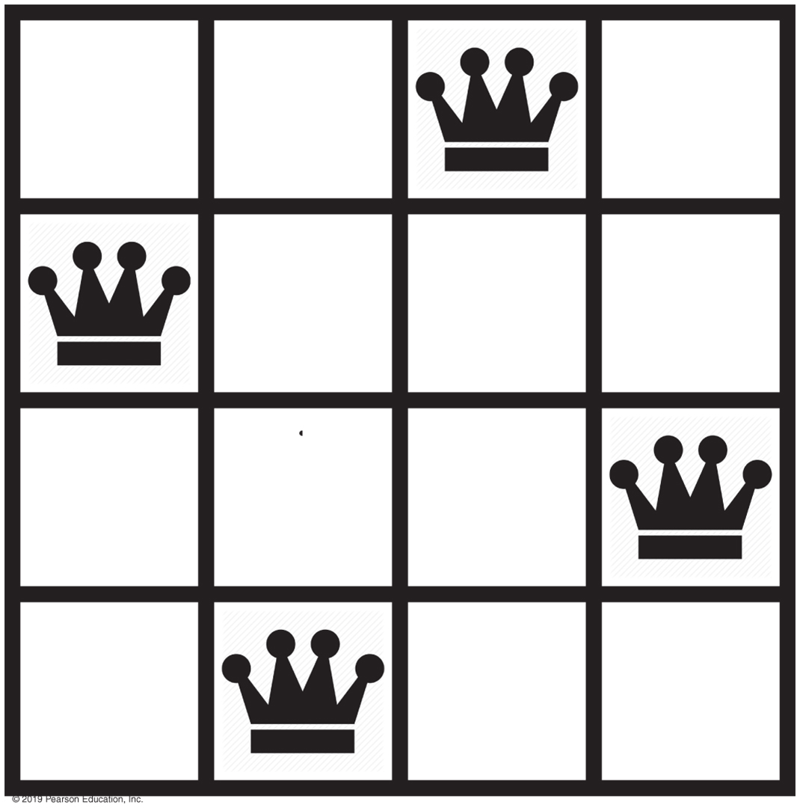
Backtracking
FIGURE 14-7 A solution to the four-queens problem

Slide 64
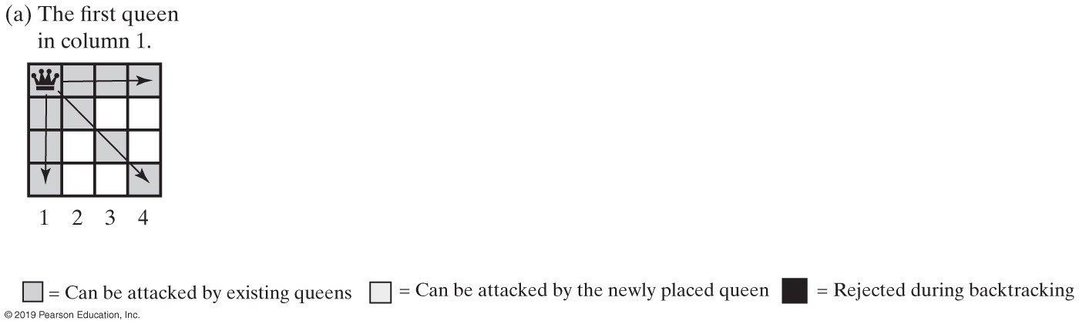
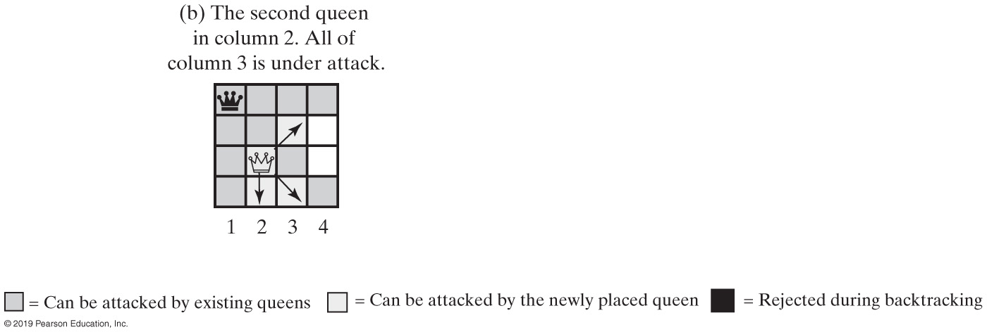
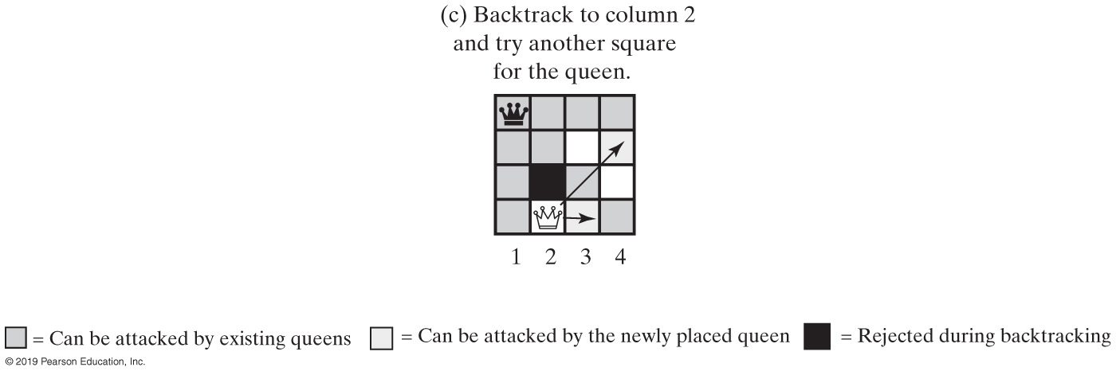
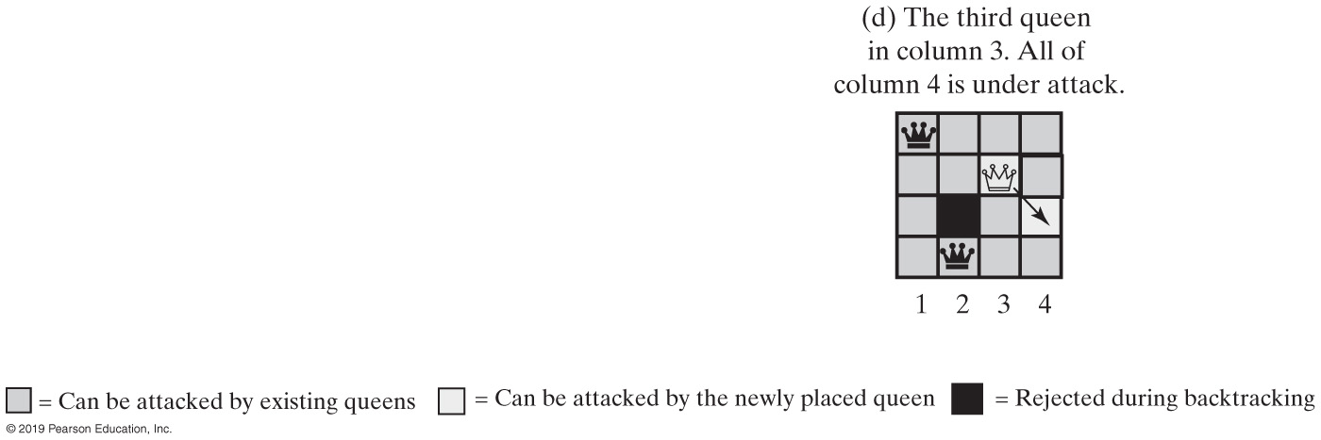
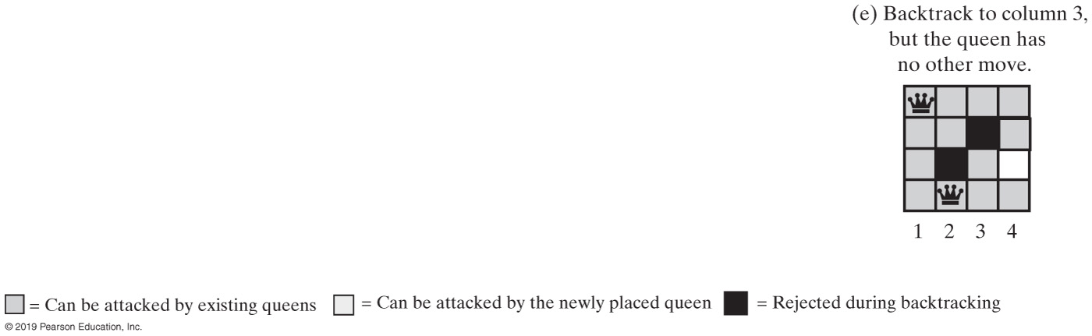
Backtracking - Queens Solution (Part 1)
FIGURE 14-8 Solving the four-queens problem by placing one queen at a time in each column

Slide 65
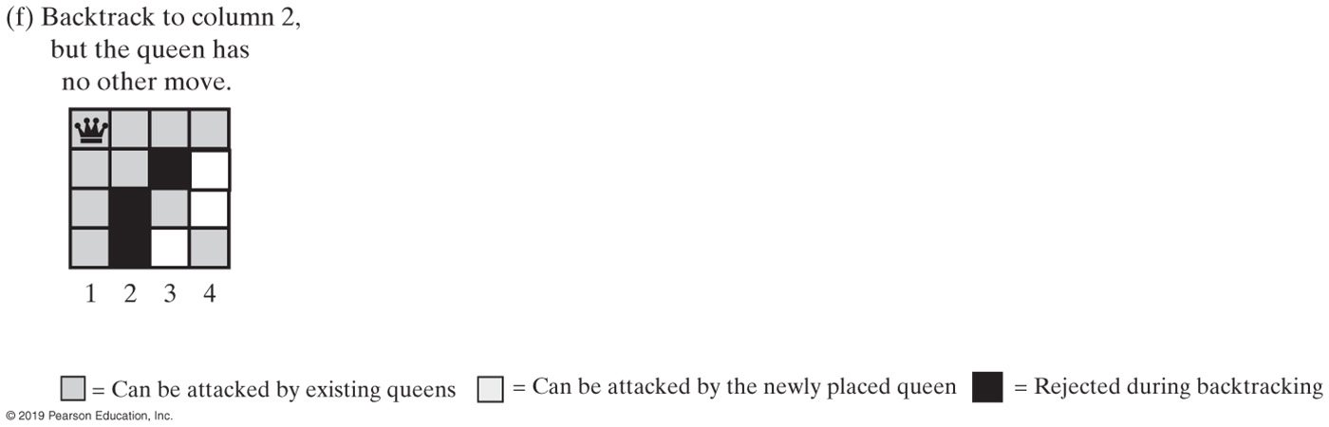
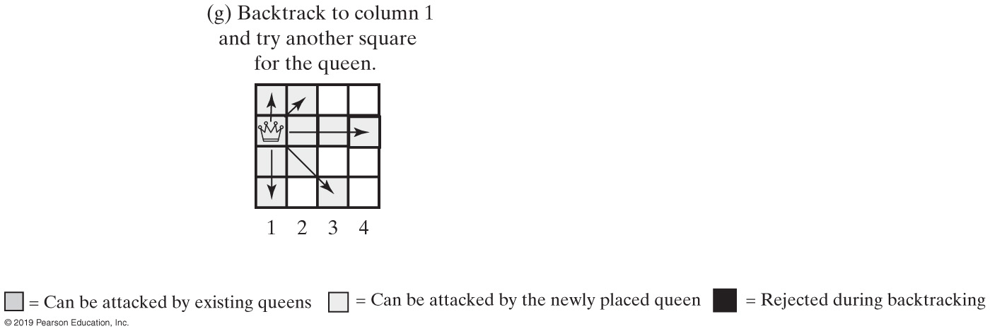
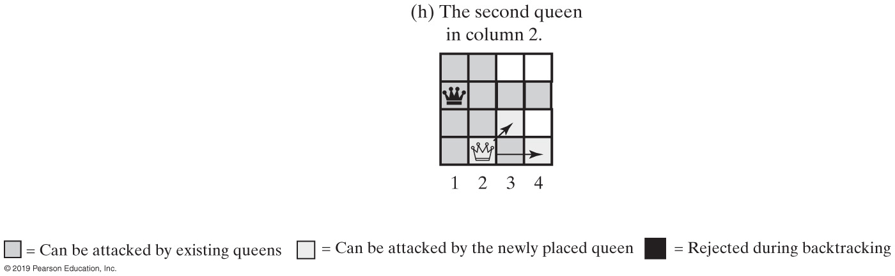


Backtracking - Queens Solution (Part 2)
FIGURE 14-8 Solving the four-queens problem by placing one queen at a time in each column

